Slide 1

Algorithms
Week 4 – RECURSION

Slide 2
Definition of Recursion

Slide 3
Definition of Recursion
A recursive function is a function that calls itself.
Example:
5! -> factorial(5)
5 x factorial(4)
General: n! = n x (n-1)!
Notes:
Demo in python how factorial fails is implemented without base case

Slide 4
Recursion is an alternative to loops
Loops:
Faster (generally)
Use less memory (generally)
Recursion:
Less code
Closer to a mathematical definition

Slide 5
Recursion is an alternative to loops
Loops:
Faster (generally)
Use less memory (generally)
Recursion:
Less code
Closer to a mathematical definition
Clearer!

Slide 6
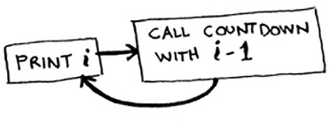
Base case and recursive case
Notes:
Show this program

Slide 7
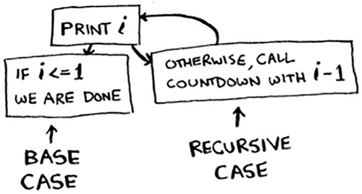
Base case and recursive case
Notes:
def CountDown(n):
print(n)
if (n > 1):
CountDown(n-1)

Slide 8
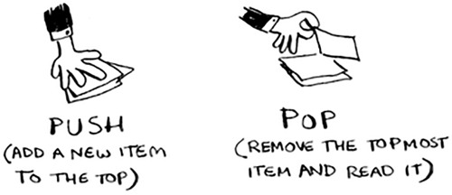
The Stack
Notes:
Tell about its counterpart: the heap

Slide 9
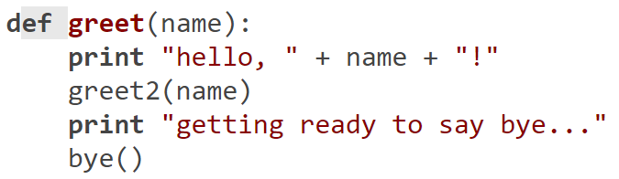
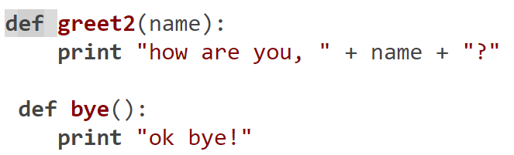
The Call Stack

Slide 10
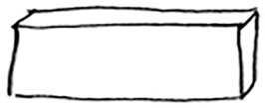
The Call Stack

Slide 11
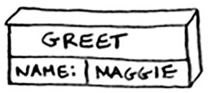
The Call Stack

Slide 12
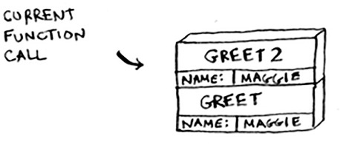
The Call Stack

Slide 13
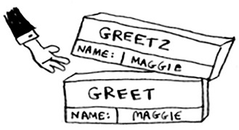
The Call Stack

Slide 14
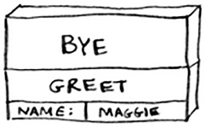
The Call Stack

Slide 15
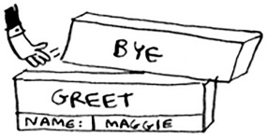
The Call Stack

Slide 16
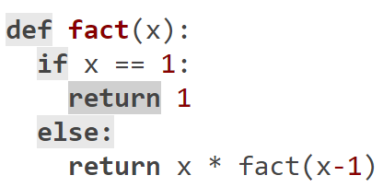
Call Stack With Recursion

Slide 17
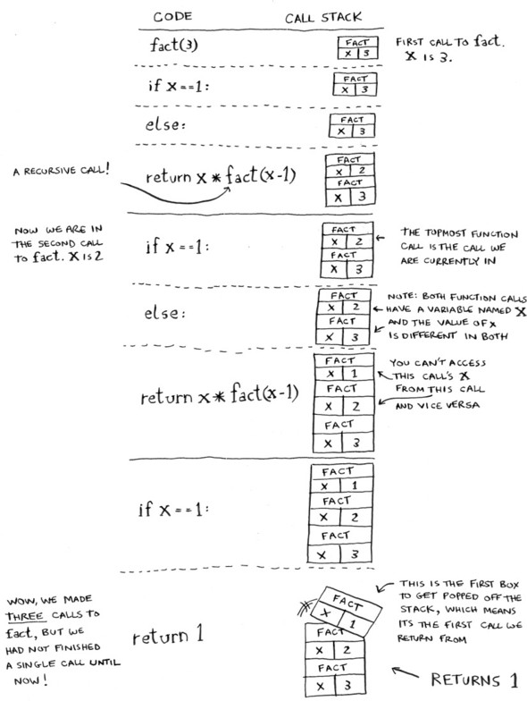
Call Stack With Recursion
Let’s call fact(3)

Slide 18
Call Stack With Recursion
Let’s call fact(3)

Slide 19
Call Stack With Recursion
Let’s call fact(3)

Slide 20
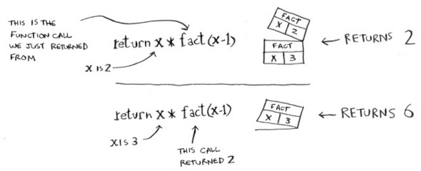
Call Stack With Recursion
Let’s call fact(3)

Slide 21
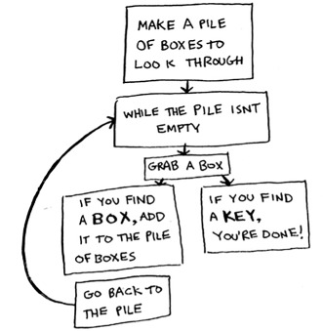
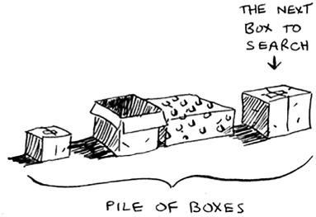
Loops vs Recursion

Slide 22
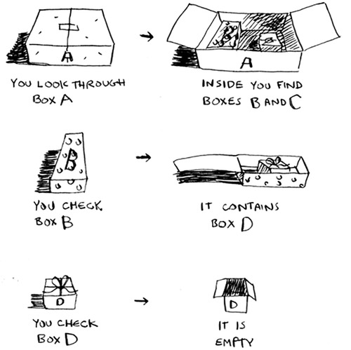
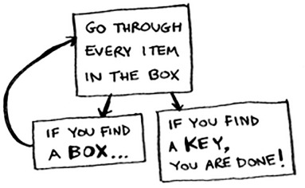
Loops vs Recursion

Slide 23
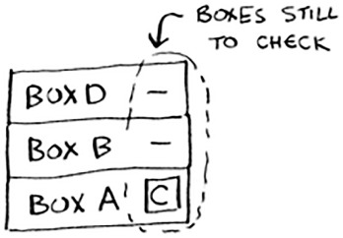
Loops vs Recursion

Slide 24
Recap
Recursion is when a function calls itself.
Every recursive function has two cases: the base case and the recursive case.
A stack has two operations: push and pop.
All function calls go onto the call stack.
The call stack can get very large, which takes up a lot of memory.

